Slide 1
Exploring Linear Regression: An In-depth Analysis of Predictive Modeling

Slide 2

Introduction
An iin-depth analysis of lliinear regression for prediictiive modelling.. Understandiing the priinciiples and appliications of llinear regression iin data anallysis and prediictiion.. Explloriing the key concepts and techniques for building accurate predictive modells using llinear regression..

Slide 3


Understanding Linear Regression
Exploring the fundamentall concepts of llinear regression.. Understandiing the relationshiip between the dependent variiablle and one or more independent variiablles.. Examiining the assumptions and llimitations of linear regression for predictive modeling..

Slide 4
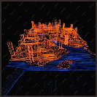
Model Building Techniques
Explloriing the techniiques for buildiing accurate prediictiive models using linear regression.. Understanding the process of modell sellection,, feature engiineeriing,, and evalluation metriics for lliinear regression models..

Slide 5
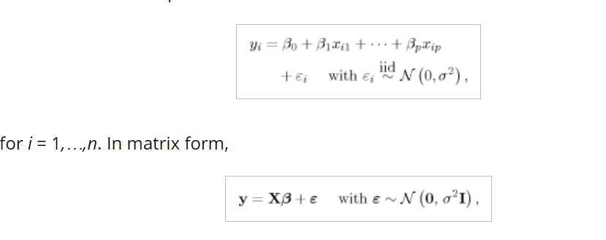
Model Building Techniques

Slide 6
Model Building Techniques
There are four major statistical assumptions involved in the speciﬁcation of model (1) or (2), and they are
(Linearity) μ ≡ [E(yi|xi)]n×1 = Xβ;
(Independence) εi’s are independent of each other;
(Homoscedasticity) εi’s have equal variance σ2;
(Normality) εi’s are normally distributed.

Slide 7

Evaluating Model Performance
Examiiniing the methods for evaluatiing the performance of llinear regression models.. Understanding R-squared,, mean squared error (MSE),, and residual analysis for assessing modell accuracy and relliabiliity..

Slide 8
R-squared (R²):
R-squared iis a statisticall measure of how cllose the data poiints are to the ﬁtted regression line.. It iis a proportiion of the variance iin the dependent variiablle that is predictablle from the independent variables.
l.. Range:: 0 to 1, where 0 indiicates poor ﬁt and 1 indiicates a perfect ﬁt..I
2.. Interpretation:: Measures how wellll the modell expllains variiability iin the data
5.. ..Consideratiion:: Should not be the sole criiteriion for modell evaluation..

Slide 9
Residual Analysis:
l.. Deﬁniitiion:: Examiinatiion off diffferences between observed and prediicted vallues ((resiidualls))..
2.. Residuall Plot:: Scatter plot off resiidualls agaiinst predicted vallues to identify patterns..
5.. Normallity off Residuals:: Check ffor normall diistributiion usiing hiistogram or Q-Q plot..
4.. Homoscedastiicity:: Resiiduals shoulld have constant variiance across predicted vallues.Independence:: Residuals shoulld be iindependent;; autocorrelatiion suggests a lack off independence..
5.. IImportance:: Assesses modell
assumptions and iidentiiﬁes potentiiall iissues..

Slide 10


Applications of Linear Regression
Exploring the diverse applicatiions of lliinear regression in variious ﬁelds such as ﬁnance,, marketing,, heallthcare,, and sociall sciiences.. Understanding how llinear regression is used for forecasting,, trend anallysis,, and risk assessment..

Slide 11

Conclusion
Summariizing the key takeaways from our exploration of llinear regression for predictive modeling.. Emphasiziing the iimportance of understandiing the princiiples and techniiques of linear regression for accurate predictiive modelling iin diverse domaiins.

Slide 12
Thanks!
Do you have any questiions? youremaill@emaiil.com
+91 620 421 838
www..yourwebsite..com @yourusername

